Slide 1
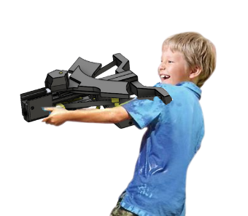
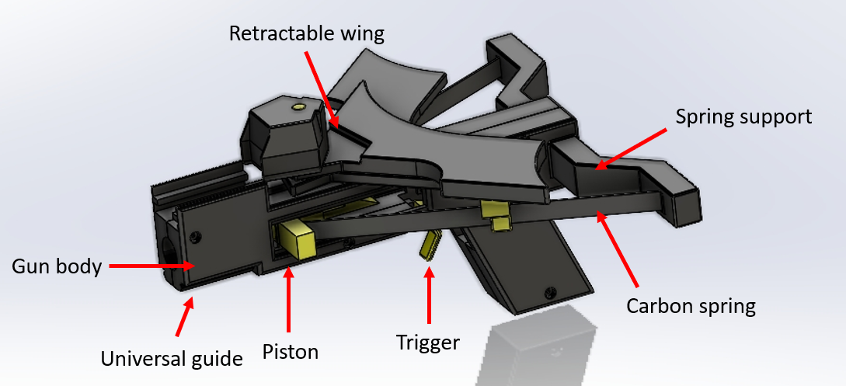
VG100 • Introduction to Engineering
Modifiable Batman Toy Gun with CFM
Instructors: Dr. Shane Johnson, Dr. Irene Wei
Team Members: Tampraphon Lorattanasane, Soo Wei Jie, Fang Haobo,
Satenik Margaryan, Zheng Haotian
Problem
Nerf guns on the market require a large force to pull back and reload, resulting in inconvenience for young children. Most Nerf guns on the market simply look like normal toy guns that function well but have no interesting aesthetic appeal or mechanisms. This problem causes the product lifespan of Nerf guns to be very short. Nerf sells modifiable gun components separately from the original gun bundle, which cost a lot of money.
Concept Generation
Our project aims at building a toy gun with fancy appearance and cool gun attachments that are provided together with the gun. We’ll also make the gun easier to reload for young customers.
Design Description
An appealing toy gun utilizing constant force mechanism is our final solution. We use Constant Force Mechanism springs in our gun rather than traditional Hooke's law springs.
We make use of the movement of the springs (carbon fiber strips) to drive a pair of retractable Batman wings. When kids reload the gun, the wings will expand, which will greatly improve the gun's appeal and innovativeness. We also provide modifiable parts together with the gun. These modifiable parts include a Batman flashlight and a laser pointer that can be used for aiming. Universal guide rail will be added to the gun body for those attachments.
Modeling and Analysis
We come up with our project in four main steps. First, we conduct market research to collect common problems of existing toy guns in the market. Then, we use the scaling formulae of the CFM mechanism spring to figure out the data about the CFM springs: such as the dimensions of the springs and the angle they must make with the gun. Next, we use Solidworks drawings to visualize the prototype to see if it meets the demand of appearance and safety. Finally, we print the gun out and test the reloading force and the shooting distance for further improvement.
Validation
To better show our product’s performance, we do some comparing tests between our batman nerf gun And the Nerf RIVAL XVIII-500 (200RMB). We let the two guns shoot at the same height horizontally for 5 times and take the average distance.
For the appearance, modifiability…... we invite a few children and adults to give marks from 1 to 5 level (5 is the best)
Table 1: Test result
Our gun shoot almost as far as the Nerf gun with less reloading force. And the testers give higher marks on reloading experience, cost performance, modifiability and portability, but surpassing mature product on appearance is still difficult, and the durability is still limited by the material and mechanism we use. We need to get more detailed feedbacks to make improvements.
Conclusion
The project solves the problem by
providing a novel mechanism and novel aesthetic design. We created an innovative toy that provides excellent user experience for children. One possible improvement for our project is to get feedback from more testers and make the gun more safe and durable. This gun not only allows children to enjoy a more comfortable and fun playing experience, but also give parents an option for safer toys.
Acknowledgement
Dr. Shane Johnson, Dr. Irene Wei, and Teaching Assistants [Cao Xiwen, Xu Jiaxuan]. More project information, please contact: [orzorzorz@sjtu.edu.cn].
 | our gun | NERF RIVAL XVIII-500
Distance | 8m | 9m
Reload force | 12N | 23N
Weight | 300N | 480N
Appearance | 4 | 4
Cost | 3 | 2
Durability | To be seen | 4
Modifiability | 4 | 3
Portability | 4 | 3
Fig. 1 The whole gun
Fig. 2 The gun components

