Slide 1


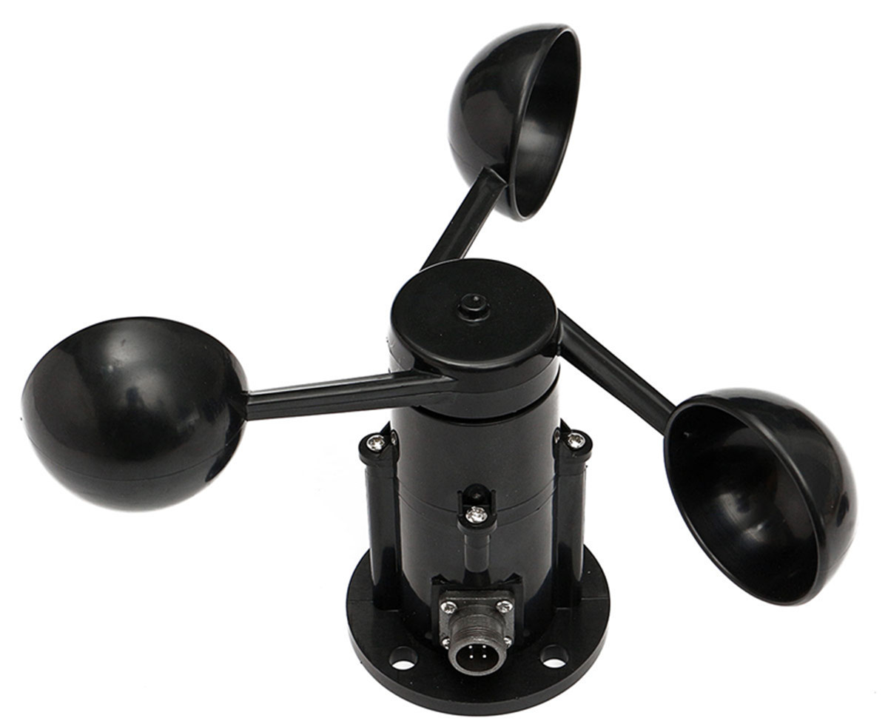
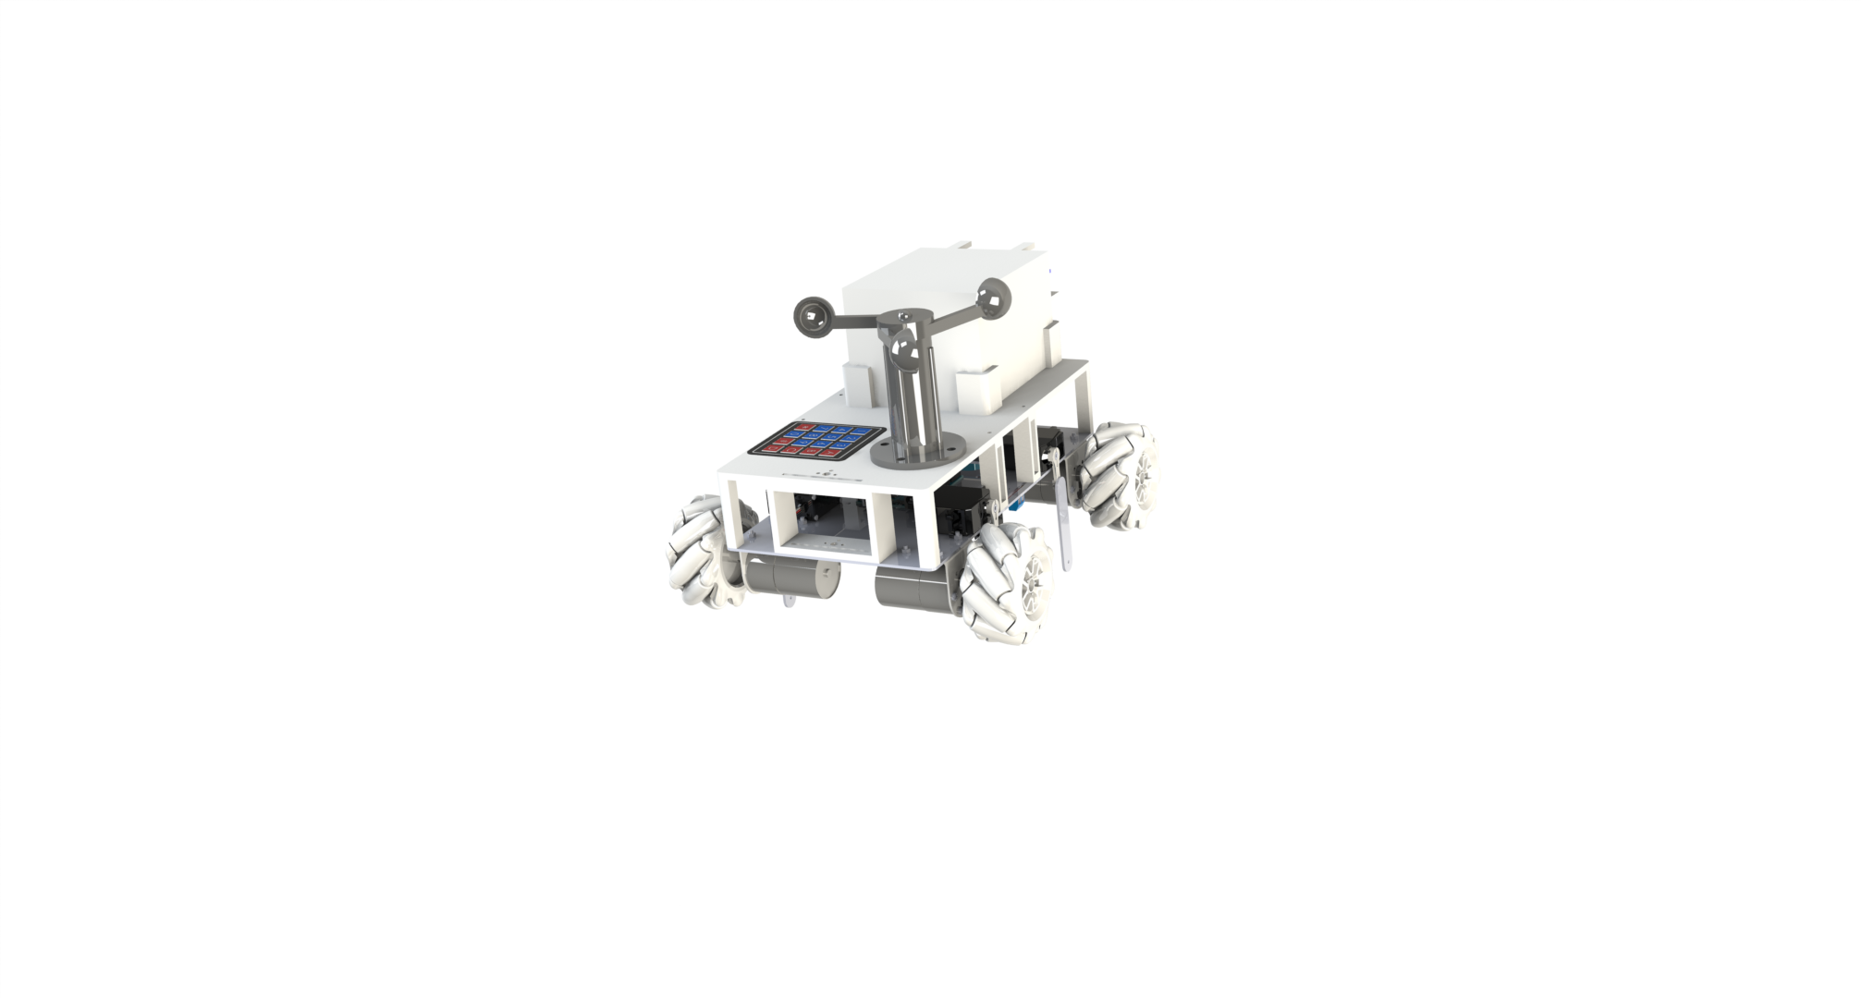
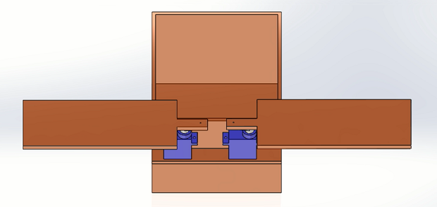
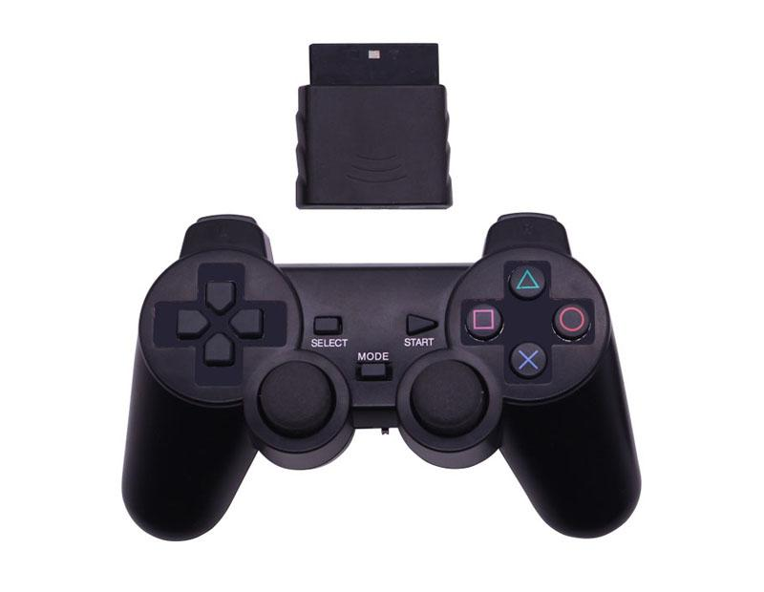
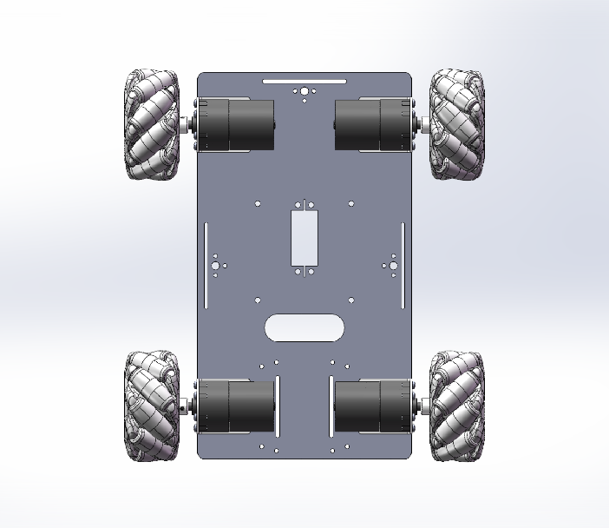
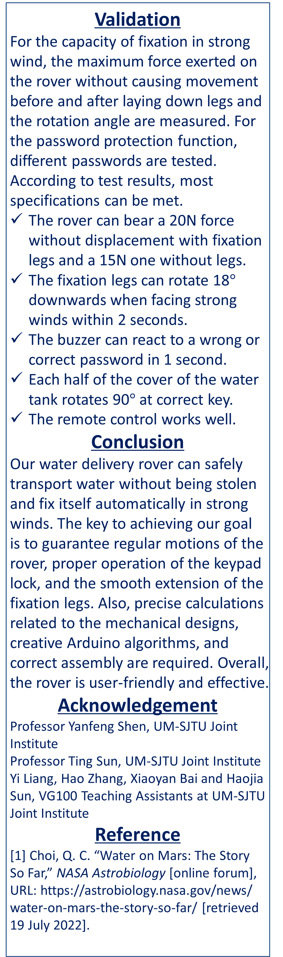
VG100 •Introduction to Engineering
Mars Water Delivery Rover
Instructor: Prof. Yanfeng Shen, Prof. Ting Sun
Team Members: Siyuan Yang, Dong Ding, Yile Sun, Yuan Kang, Jiahe Huang,
Ziyang Xiong
Problem Statement
In order to live more comfortably on Mars, water resources are essential for people. But Mars is lack liquid water resources, and most of the water exists in the form of glaciers. Besides, the weather conditions on Mars are harsh, often stormy weather, making it difficult for the water delivery rover to run steadily. This project aims at building a prototype that can deliver water and remain stable in harsh environments.
Needs
Alarm if the password is wrong.
Automatically open the water tank lid if the password is correct.
Automatic alarm when the wind is strong and extends the mechanical legs.
Design Description
Fig. 1 Water Delivery Rover’s structure
The overall design of the Mars Water Delivery Rover has four main modules, including a motion module, a fixation module, a monitor module, and a loading module.
Fig. 2 Structure of the motion module
The motion module includes four DC motors which are directly connected to Mecanum wheels. The main function of this module is using a PS2 handle and Bluetooth with designed
Arduino codes to remote control the rover moving in any direction.
The fixation module consists of four legs powered by four servos. The main function of this module is to extend the mechanical leg when the wind is strong to help the rover stay stable in the harsh environment.
Fig. 3 The wind speed sensor
The monitor module mainly consists of a wind sensor, a keyboard, and a buzzer, controlled by Arduino codes automatically. With excessive wind speed or the wrong password, the rover will sound an alarm to ensure the safety of water delivery.
Fig. 4 Structure of the water tank
The loading module consists of a water tank, which could be opened only with the correct password. Functions of this part include anti-theft, removable, and color-changing.
Significance of Solution
The motion capacity of the rover is optimized by applying Mecanum wheels, which can roll smoothly. This method largely protects the motion components and increases the rover’s lifespan. The remote control design also makes it more user-friendly. In addition, the water tank is fixed to the chassis by four L-slots for easy assembling. The water tank is also 3D printed so that it is more accurate in size and does not leak easily. Golden Hill in Beijing is also played with the correct key to improve the aesthetic.
Fig. 2 Ansys Analysis
For the rover, math models are derived from bionic gait analysis, making the legs’ movements smooth, consistent, and well-coordinated.
Fig. 3 Example of Gait Analysis[1]
Given the position of each foot in the cartesian coordinate system, the Arduino controller will transform it to the angles of the joints and adjust the servomotors correspondingly.
Fig. 4 Coordinate Transformation
…
…
Validation
For the capacity of fixation in strong wind, the maximum force exerted on the rover without causing movement before and after laying down legs and the rotation angle are measured. For the password protection function, different passwords are tested.
According to test results, most specifications can be met.
The rover can bear a 20N force without displacement with fixation legs and a 15N one without legs.
The fixation legs can rotate 18$°$ downwards when facing strong winds within 2 seconds.
The buzzer can react to a wrong or correct password in 1 second.
Each half of the cover of the water tank rotates 90$°$ at correct key.
The remote control works well.
Conclusion
Our water delivery rover can safely transport water without being stolen and fix itself automatically in strong winds. The key to achieving our goal is to guarantee regular motions of the rover, proper operation of the keypad lock, and the smooth extension of the fixation legs. Also, precise calculations related to the mechanical designs, creative Arduino algorithms, and correct assembly are required. Overall, the rover is user-friendly and effective.
Acknowledgement
Professor Yanfeng Shen, UM-SJTU Joint Institute
Professor Ting Sun, UM-SJTU Joint Institute
Yi Liang, Hao Zhang, Xiaoyan Bai and Haojia Sun, VG100 Teaching Assistants at UM-SJTU Joint Institute
Reference
[1] Choi, Q. C. “Water on Mars: The Story So Far,” NASA Astrobiology [online forum], URL: https://astrobiology.nasa.gov/news/
water-on-mars-the-story-so-far/ [retrieved 19 July 2022].
receiver
PS2
wheels
motors

